Slide 1
Teaching Digital Citizenship Our School’s Commitment

Slide 2
Teaching Digital Citizenship
Fulton County School has once again partnered with Common Sense Media to provide Digital Citizenship lessons and resources for students, teachers and parents.

Slide 4
Why teach digital citizenship?
1
Kids spend an average of 53 hours a week using media and technology. That’s over 7 hours a day, and it doesn’t include time spent texting or doing schoolwork.
2
Technology offers kids great opportunities for self-exploration, creativity, connection and learning, yet kids may also experience challenges like:
Oversharing and damage to reputation
Cyberbullying
Not understanding how to analyze and evaluate the credibility of information
3
To harness technology for learning, kids need to understand how to think critically, behave safely, and participate responsibly online.
Notes:
Presentation objectives

Slide 5
What we’re doing
Using resources from Common Sense Education to teach students digital literacy and citizenship skills and engage parents
Common Sense is a national, non-profit organization that provides free resources to educators and advice to parents so that kids can harness the power of technology for learning and life

Slide 6
Digital Citizenship Lessons For Students
Elementary
Media Balance (K-2)
Digital Footprints (K-2)
Internet Safety (K-2)
Private vs. Personal Information(3-5)
Cyberbullying – The Power Of Words(3-5)
What Is Clickbait? (3-5)
Middle School
Digital Footprint and Identity
Cyberbullying, Digital Drama and Hate Speech
Relationships and Communication
High School
What's Your Digital Footprint?
Cyberbullying
Oversharing and Risky Behaviors

Slide 7
Digital Citizenship Lessons For Teachers
Educators and Social Media: Avoiding the Pitfalls
Protecting Students' Privacy Online

Slide 8
We know that with all the advantages the Internet can bring to your family’s life, there can also be pitfalls.
To help you talk with your children about Internet Safety and how to be a good Digital Citizen, the following links to Common Sense Media’s Parent Resources will be available on our school’s Media Center webpage.

Slide 9
Parent Resources For Digital Citizenship
Cyberbullying Resources for Parents and Families
Once kids go online, their chances of finding cyberbullies, haters, and trolls is, sadly, quite high. Find age-specific guidelines, videos, and articles to help with tough conversations -- whether your kid is a bully or is being bullied. Common Sense Media answers all your cyberbullying questions, offering age-appropriate advice, school resources, and more from parents and experts.
Online Safety Resources for Parents and Families
To help kids maximize the Internet's benefits -- while minimizing the risks – Common Sense Media offers the latest research, tips, and tools on what really keeps kids safe. Which privacy settings should you use? What are the ins and outs of parental controls? Get tips on everything from the basics, such as smart usernames, to the big stuff, such as appropriate sharing.
Resources about Social Media Devices for Parents and Families
Getting a cellphone has become a milestone for most kids. Common Sense helps parents lay the groundwork for responsible cellphone use and manage the challenges and opportunities they bring. Learn how to decide the right age to get your kid a cellphone, set rules, choose the right phone and service plan, and stay on top of what your kid is doing on his or her phone.

Slide 10
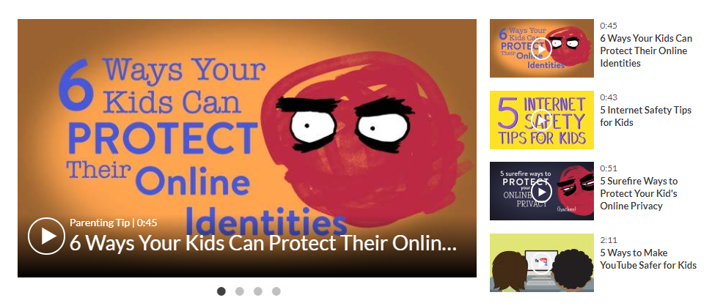
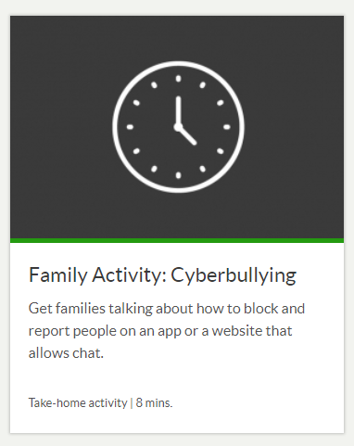
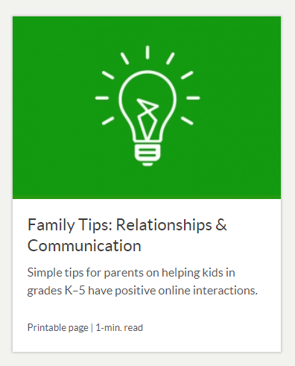
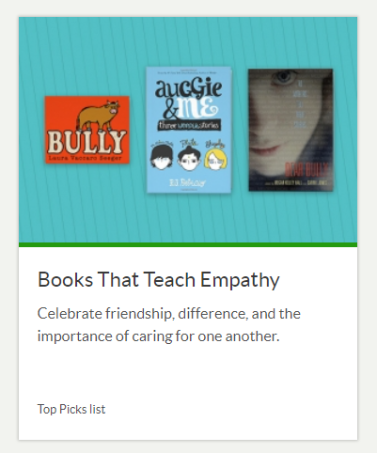
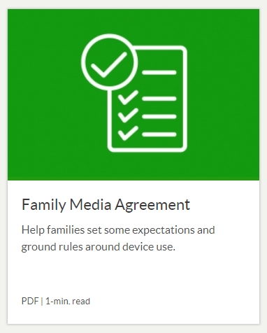
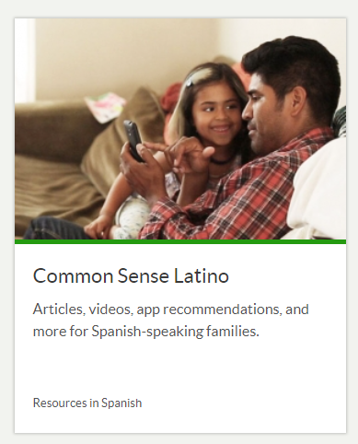
Examples of some of the
Common Sense Media
Parent Resources

Slide 11
Instructions for adding Parental Controls for TV and Internet Providers

